Slide 1
CMSC 140 Lecture 2
Chapter 1 – Introduction to Computers and Programming
Dr. Ahmed Tarek
Montgomery College CMSC 140

Slide 2
Class Objective
Discuss hardware and software
Discuss programs and programming languages
Discuss programming and problem solving using C++ programming language
Classroom assignment on programming and problem solving
Montgomery College CMSC 140

Slide 3
YouTube Video Links for the History of Computers
Detailed History of the Digital Computers:
https://www.youtube.com/watch?v=bGk9W65vXNA
Summary of the History of Digital Computers at University of Pennsylvania:
https://www.youtube.com/watch?v=k4oGI_dNaPc
Montgomery College CMSC 140

Slide 4
Computer Program
A computer program is a set of instructions that dictates the computer to perform a task, known as a job
  Programs are also called software
  Software are essential for computer
    Without a software, a computer can do nothing
  A computer programmer or software developer is a person with the training and skill set necessary to
    Design
    Create
    Test
    Debug computer programs
Montgomery College CMSC 140

Slide 5
Programming Paradigm
Computer programming is both an art and a science, as it involves designing:
  Logical flow of instructions
  Mathematical procedures
  Appearance of the screen
  The way information is presented to the user
  Software’s user friendliness
  Manuals & other documentation
There is also a Scientific & Engineering side
  Programs needs to be written following standard rules and syntax, called a programming language, such as C++
Montgomery College CMSC 140

Slide 6
Computer Systems-1
A computer system has two major components
  Hardware
  Software
Hardware consists of physical components (that you can touch and see), such as
  Central Processing Unit (CPU)
  Main Memory
  Secondary storage devices
  Input devices
  Output devices
The above work in harmony as a system of devices like instruments in a symphony orchestra
  Each instrument plays its own part in the orchestra
Montgomery College CMSC 140

Slide 7
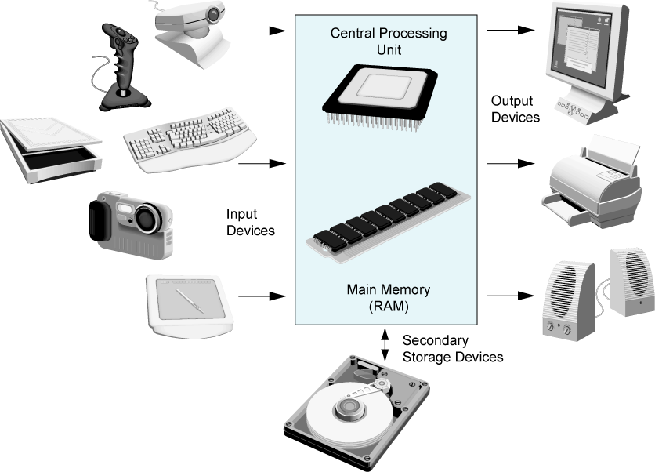
Computer systems-2
Montgomery College CMSC 140

Slide 8
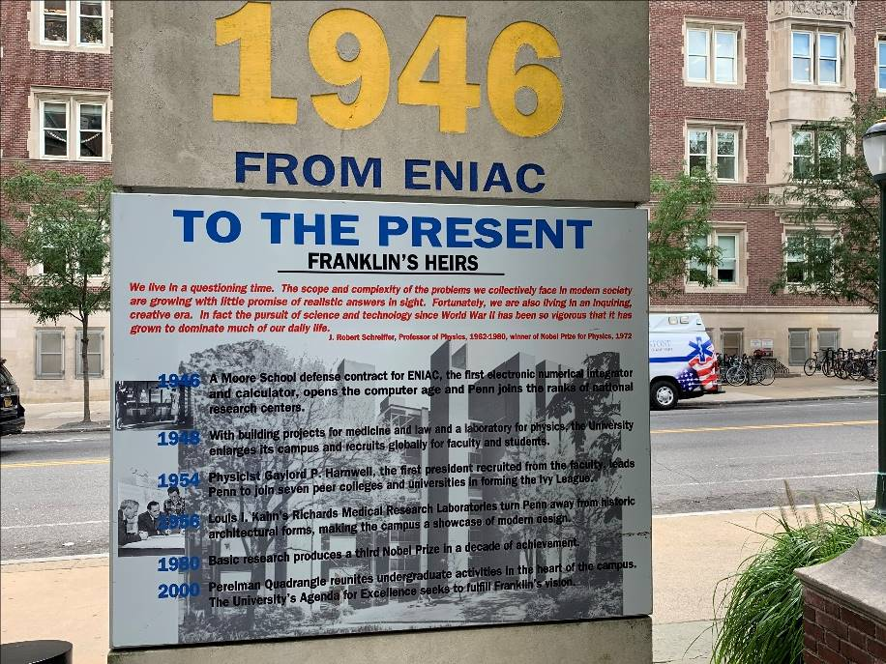
CPU-1
Like the brain of a computer – CPU runs the program
Early CPUs were huge, such as ENIAC – the First Digital Computer, which was created at University of Pennsylvania (UPenn) back in 1946
  Primarily one big CPU, which was 8 feet tall, 100 feet long, and weighed 30 tons
Montgomery College CMSC 140

Slide 9
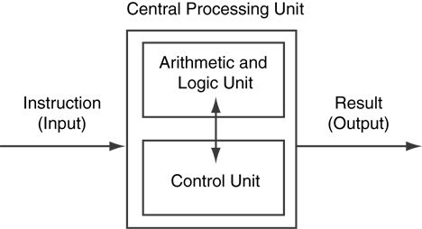
CPU-2
Modern CPUs fit in a chip known as microprocessors – also much powerful than early CPUs
Has two major components – Arithmetic & Logic Unit (ALU) and Control Unit (CU)
  ALU computes
  CU controls & coordinates activities
Montgomery College CMSC 140

Slide 10
CPU-3
Working of a CPU involves Fetch/Decode/Execute cycle
  Fetching instruction from memory
  Decoding instruction into op code and operand
  Executing Instruction according to op code
  Storing results produced
Montgomery College CMSC 140

Slide 11
Main Memory
Computer needs to store information in main memory before it can be processed by the CPU
In case of a PC, main memory is called RAM (Random Access Memory)
  CPU can quickly access information at any random location in RAM
RAM is volatile that is used only as a scratch pad temporary memory while a program is running
If the electrical power is turned off, the content in RAM is erased
  RAM Consists of billions of tiny capacitors that can charge and discharge pretty fast
An area in RAM of 8 consecutive tiny capacitors is called a byte – a unit of memory space measurement
A byte can store information of a single character from ASCII (American Standard Code for Information Interchange)
Modern computers have billions of bytes of RAM storage
Montgomery College CMSC 140

Slide 12
Secondary Storage
Secondary storage can hold information permanently
  Even if the electrical power is turned off, it doesn’t loose information
It uses magnetic technology because it is cheaper
  Has metallic or plastic platter coated with magnetic oxide particles
  Examples include Hard Disk, Floppy Disk, zip disk, etc
USB flash drives use semiconductor technology and plugs directly into USB slots – faster than Floppy or zip disk
Compact Disk (CD) and Digital Video Disk (DVD) use laser (light amplification through stimulated emission of radiation) technology
  So there is no mechanical friction between the read-write device and the data on the circular plastic surface
  Avoids mechanical wear and tear – more reliable
Montgomery College CMSC 140

Slide 13
Input & Output Devices
Input devices convert human understandable information to computer readable 1/0 format
Examples include mouse, keyboard, scanner, etc.
Disk Drive, USB flash drives, and CD/DVD drives may also be used as input devices as they can store information in the form of files
Output devices convert machine processed information to human understandable form
Examples include monitor screen, printer, speaker, etc.
USB flash drives, Disk drives, CD/DVD drives can be used as output devices as they can store the computer processed information
Montgomery College CMSC 140

Slide 14
Software
A software is a logical entity – one cannot see it but can use it stored on a media, such as USB flash drive
Software controls each and every operation inside computer
Two types of software – System Software and Application Software
Montgomery College CMSC 140

Slide 15
System Software
Without system software, computer cannot start operation. Following include common system software
Operating System: Controls and coordinates internal operation of the computer, manages devices connected to the computer, and allows data to be saved to and retrieved from storage devices, and allows other programs to run on computer
Utility Programs: Perform specialized tasks that enhances computer’s operation and safeguard data. Examples include virus protection programs, data-backup utilities.
Software Development Tools: Software tools that programmers use to create, modify, and test software. Compilers and IDE are examples, such as Visual Studio
Montgomery College CMSC 140

Slide 16
Application Software
Perform job specific tasks
Examples include MS Word for word processing, MS Excel for spreadsheet, web browser for Internet, etc.
These are programs that people normally use to get their job done
Montgomery College CMSC 140

Slide 17
Program and Programming Language
A computer program is a set of instructions that tells the computer how to solve a problem or perform a task
Computer can only understand 1s and 0s
To carry out the task of conveying the instructions from programmer’s understandable format to computer understandable format, programming languages were invented
Programming languages include C++, Visual Basic, Java, etc.
Montgomery College CMSC 140

Slide 18
Programming Languages
Two categories
  Low-level, Example: Assembly Language
  High-level, Example: C++
Low-level Languages require more instructions (so more efforts) to convey instructions to computer
As it is close to the machine understandable 1/0 binary format, often they are much faster
High level language programs are coded in English-like syntax
Easy to understand. However, needs a software called compiler or Interpreter to convert to binary machine language code that computers can process
Montgomery College CMSC 140

Slide 19
Source Code, Object Code, and Executable Code
When a C++ program is written, it is typed into the computer and saved to a file. This is called source code
During compilation, compiler translates source code into machine language instructions called object code
During compilation, programmer needs to remove any syntax mistake from the program
Common operations, such as square root of a number, is stored in a library called run-time library
During the last phase of compilation, another program called linker combines the object code to necessary library routines, and generates the executable file
The executable file runs and produces the required output
Montgomery College CMSC 140

Slide 20
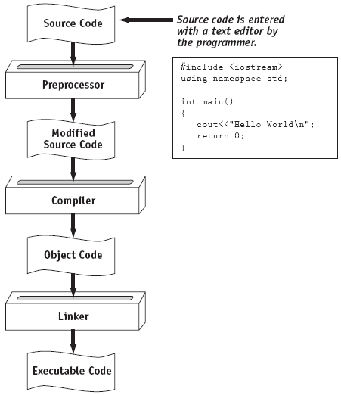
C++ Program Compilation & Execution
Montgomery College CMSC 140

Slide 21
Questions for the Class
What is the essential difference between software and hardware?
How many different types of software are there?
What type of software the compiler is?
Which is more expensive – RAM or Secondary Storage Device? Why?
What do you mean by Source Code?
Is compiler a hardware or a software?
What is a linker?
Montgomery College CMSC 140

Slide 22
Classroom C++ Assignment
Write a C++ program that computes the following expression:
(19 + 7)*4 – 4/2 + 9/3
Compile and execute the C++ program in
Visual C++ compiler.
Montgomery College CMSC 140

